Slide 1
E-Commerce Profitability Analysis & Insights
Peter Cheng | November 2025

Slide 2

Project Objective
To uncover what drives profitability across e-commerce platforms and fulfillment models through data-driven insights.
Goals:
Identify the most profitable products and sales channels.
Compare Amazon FBA vs. Merchant Fulfillment performance.
Quantify key pricing and catalog factors that impact margins.
Provide actionable recommendations for pricing, inventory, and logistics.
Outcome: Clear, data-backed strategies to improve revenue and operational efficiency.

Slide 3
The Business Problem
Company
Context
Problem statement
A fashion e-commerce retailer operating across Amazon, Myntra, Flipkart, Ajio, and international platforms.
Multiple sales and fulfillment systems (e.g., Amazon FBA, Merchant Fulfilled, Shiprocket, Increff) handle pricing, logistics, and inventory separately.
Managers need visibility into which combinations of platform, product, and fulfillment model drive profitability.
Profitability data is fragmented across platforms.
The company struggles to identify top-performing categories, clients, and fulfillment methods, limiting strategic decision-making for pricing, inventory, and operations.

Slide 4
The Business Question
Core Question:
Which product categories, sales channels, and fulfillment methods generate the highest profit margins, and what factors most influence e-commerce profitability?
Supporting Questions:
How does Amazon FBA compare to Merchant Fulfillment in sales and reliability?
Which catalogs and price structures drive consistent profit growth?
What data-driven strategies can improve pricing, inventory, and logistics efficiency?
Purpose: To guide management decisions with clear, measurable insights into where and why profits occur across platforms.

Slide 5
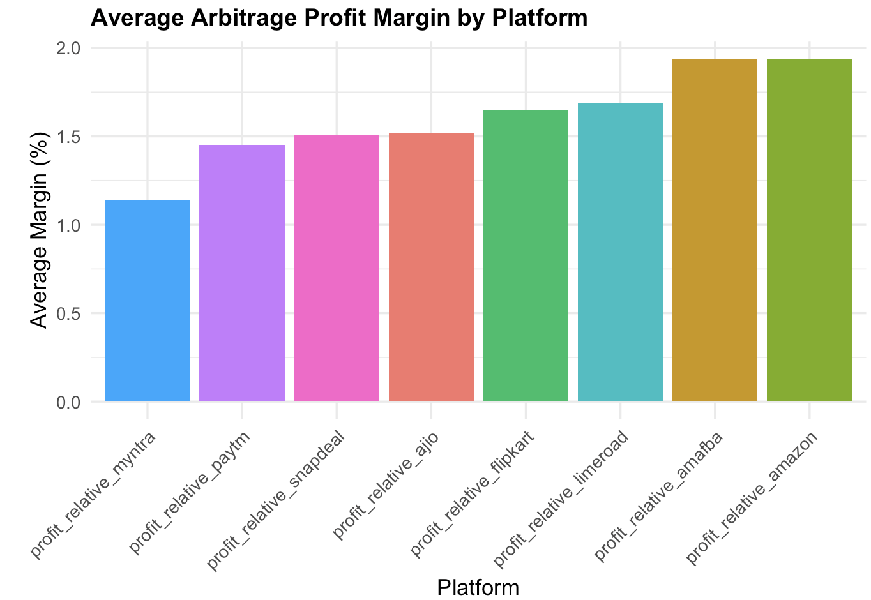
Amazon & Amafba Are the Most Profitable Platforms (~2%)
Key Takeaway:
Amazon and Amafba outperform all other platforms, while Myntra shows the lowest margins due to competitive pricing.

Slide 6
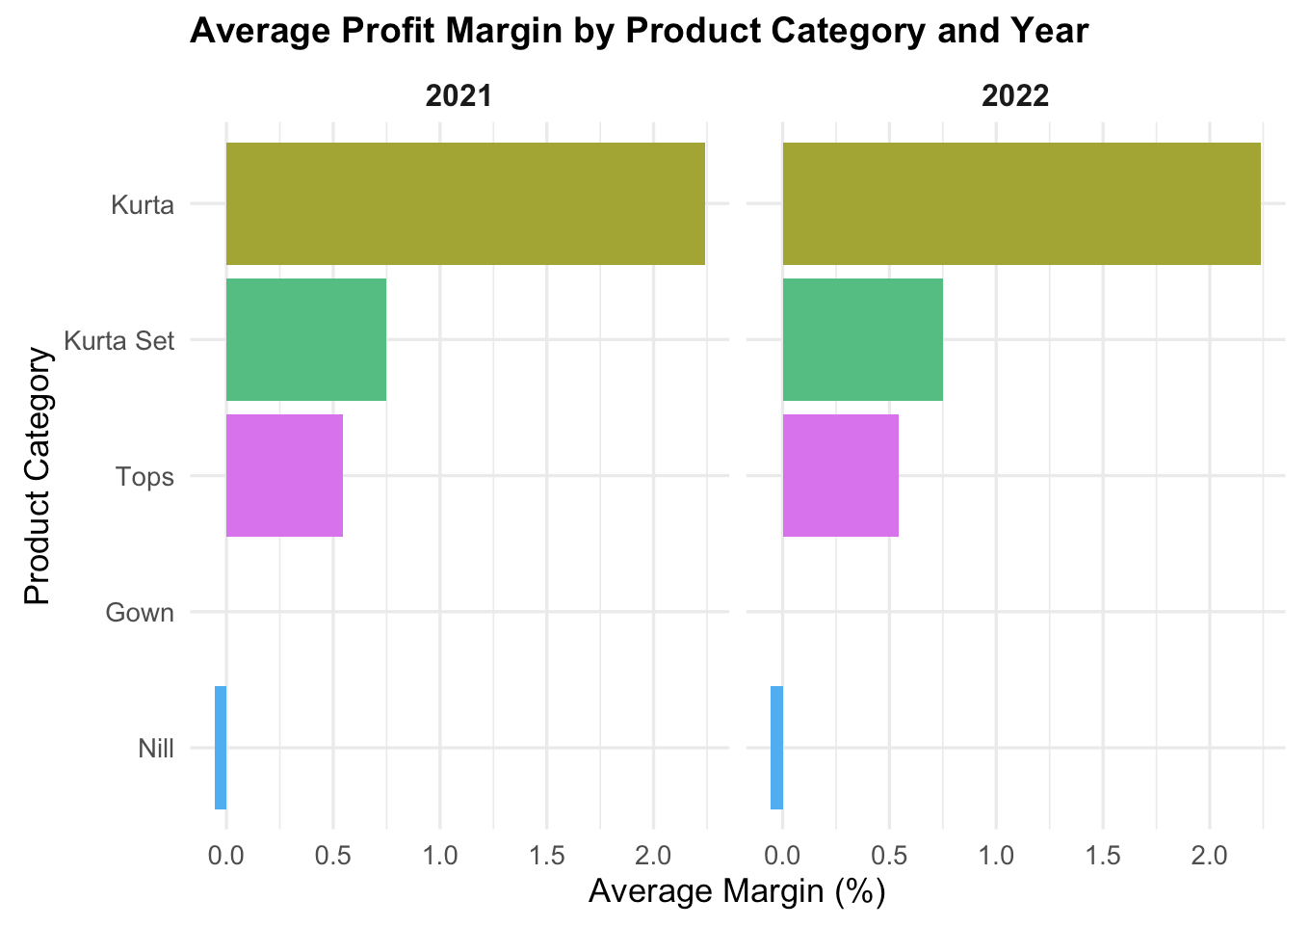
Profitability Is Category-Anchored and Stable Across Years
Key Takeaway:
Kurta and Kurta Sets consistently deliver the highest margins year-over-year.

Slide 7
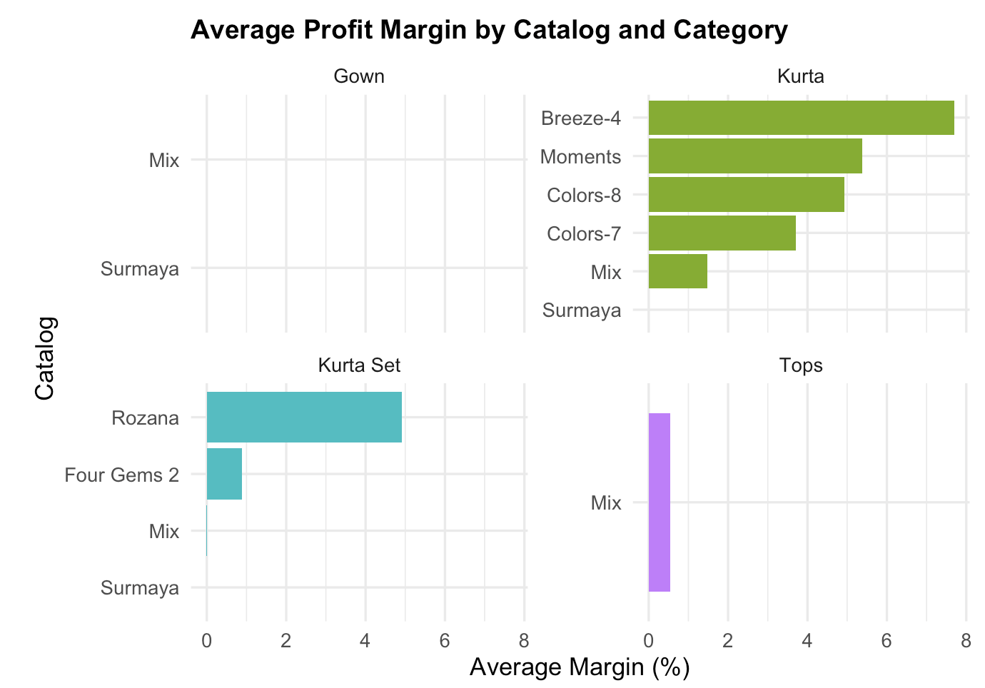
Profitability Is Catalog-Concentrated within Each Category
Key Takeaway:
Top 3 catalogs (Breeze-4, Moments, Colors-8) account for majority of profit across Kurta and Kurta Set categories.

Slide 8
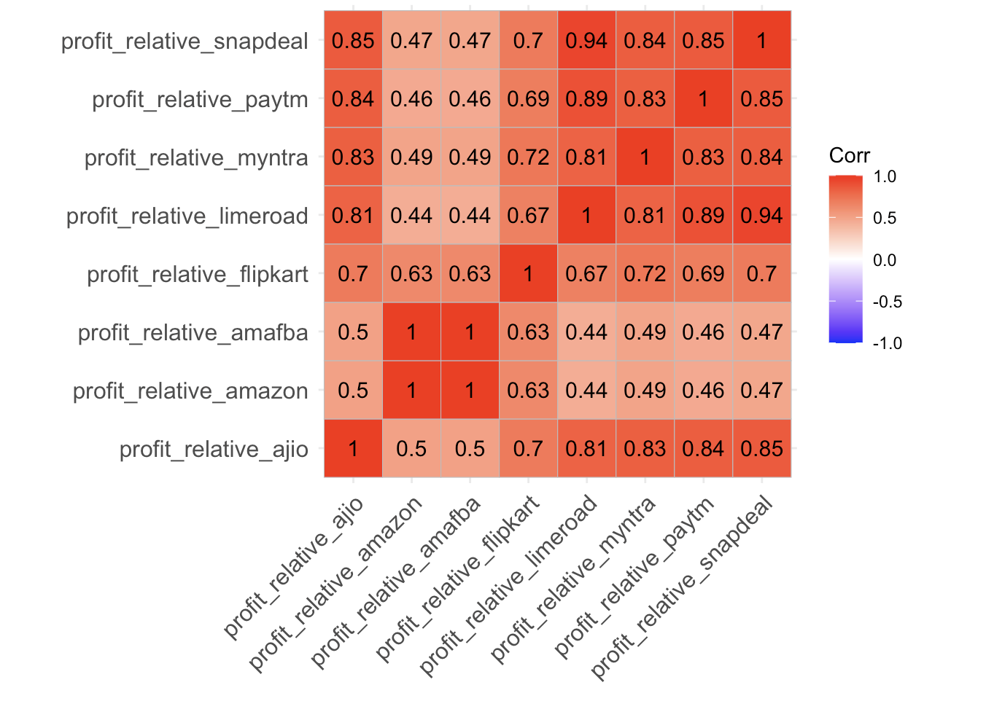
High Cross-Platform Correlation Shows Tight Market Competition
Key Takeaway:
Margins across major platforms move in sync, but Amazon maintains pricing autonomy.

Slide 9
Predictive Modeling Confirms Profitability Is Structural, Not Seasonal
LASSO / Ridge Regression
Decision Tree
Random Forest (Best Model)
price_ratio (selling-to-cost ratio) most predictive of profit
Pricing discipline and markups directly drive margin gains
Pricing thresholds (e.g., Amazon MRP < ₹2173 → higher profit)
Profits can be optimized by adjusting price bands
Confirms catalog + Amazon MRP + price_ratio as strongest features
Profitability is stable across time — driven by structure, not seasonality

Slide 10
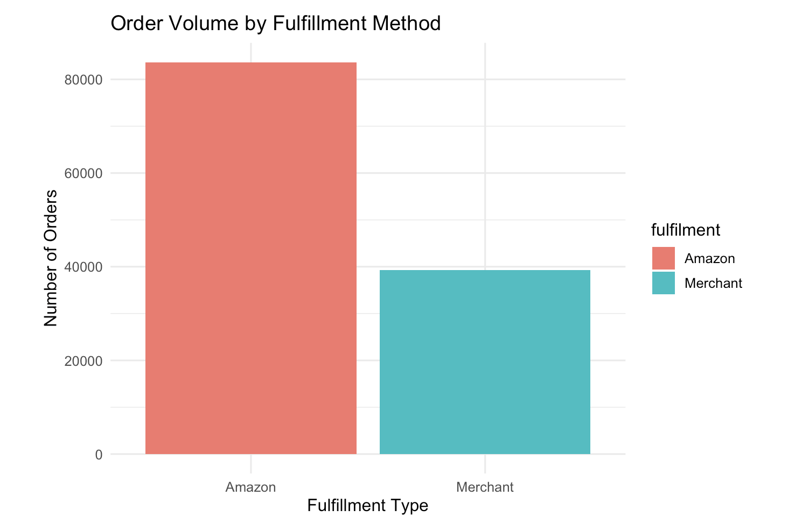
Amazon Fulfillment Handles Over Twice the Order Volume of Merchants
Key Takeaway:
Operational scale, not price wars, defines Amazon’s competitive edge.

Slide 11
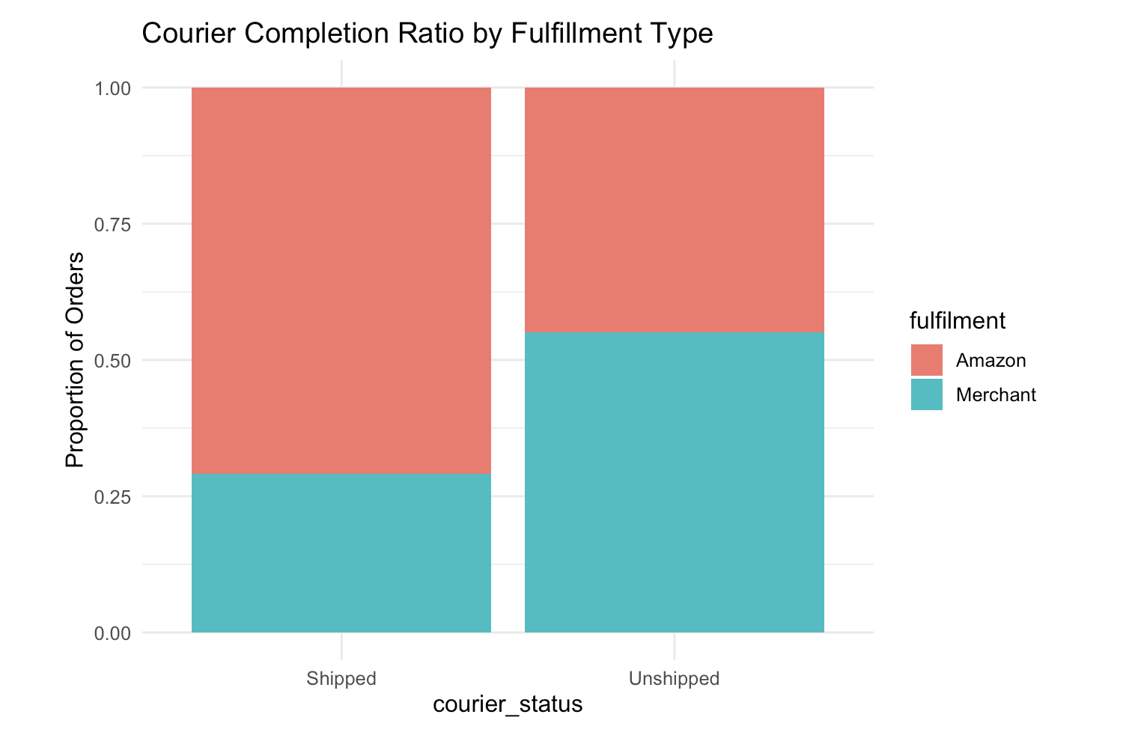
Amazon Fulfillment Ensures Faster and More Reliable Delivery
Key Takeaway:
Amazon’s fulfillment model doesn’t just scale — it delivers.
Higher shipping completion means better customer satisfaction, repeat orders, and ultimately stronger profitability.

Slide 12
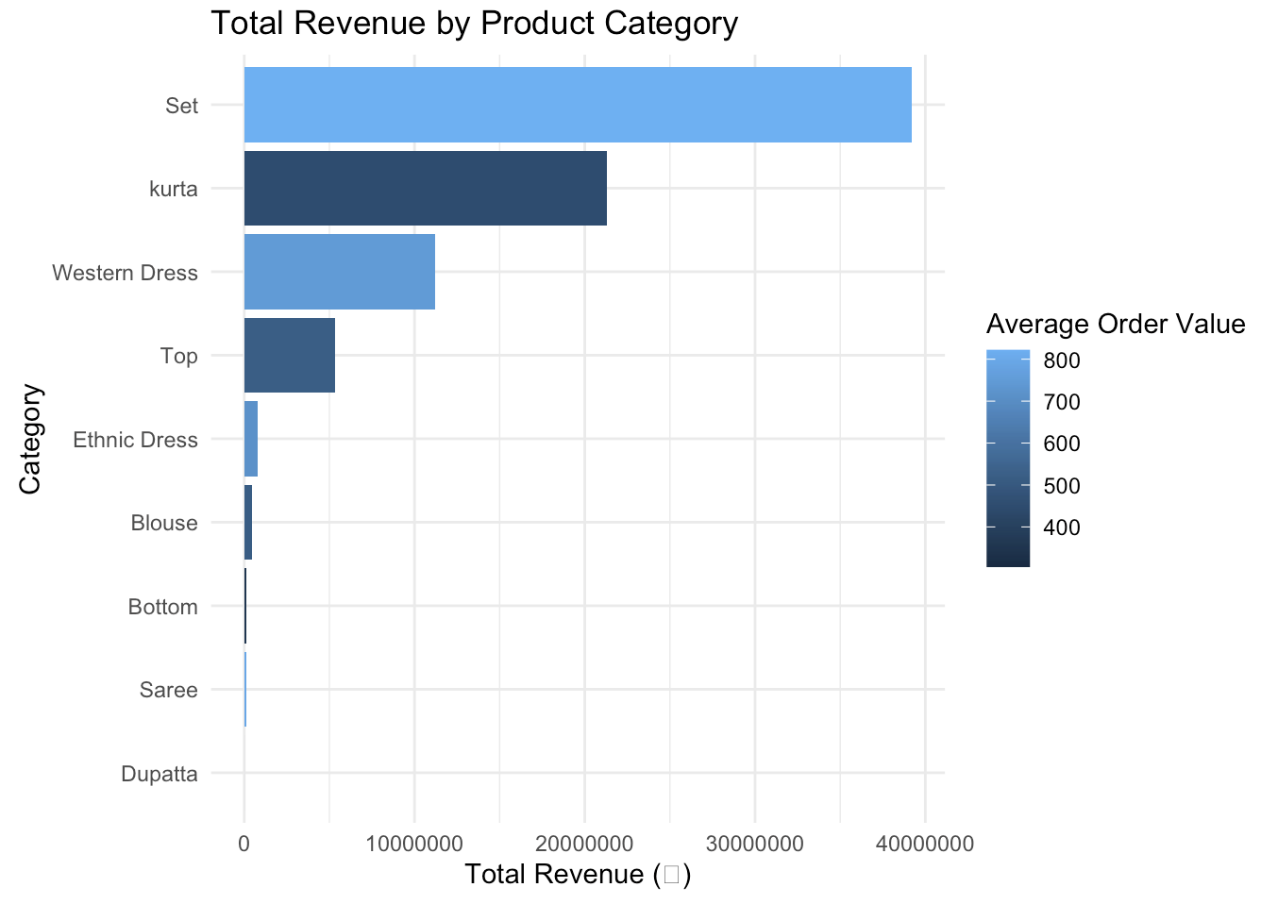
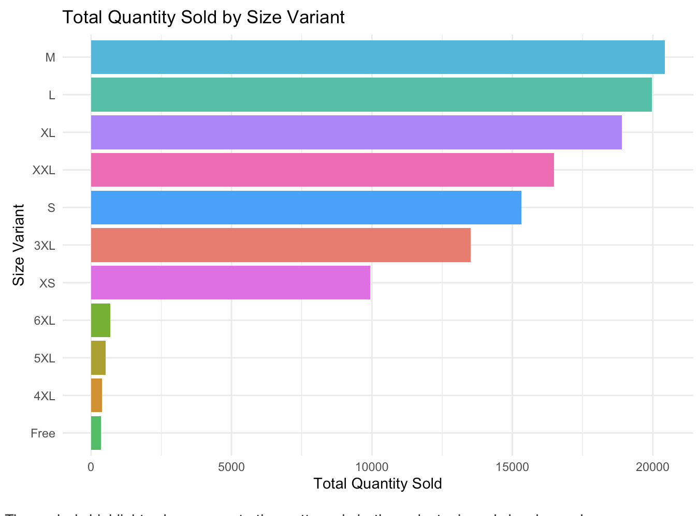
Amazon’s Product Mix Drives Revenue Through High-Value and High-Volume Segments
Key Takeaway: Amazon wins not only by platform reach, but through product precision — capturing value in top-selling categories while sustaining consistent sales across core size variants.

Slide 13
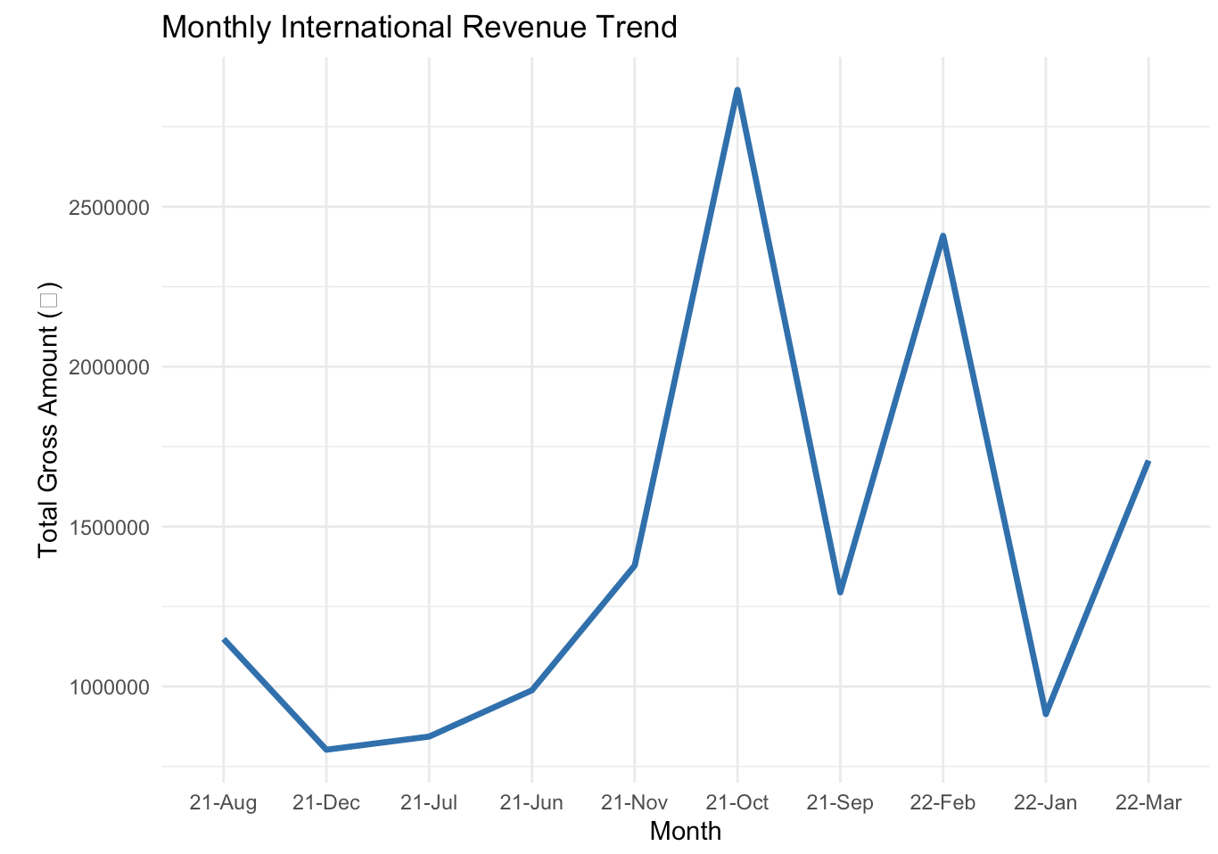
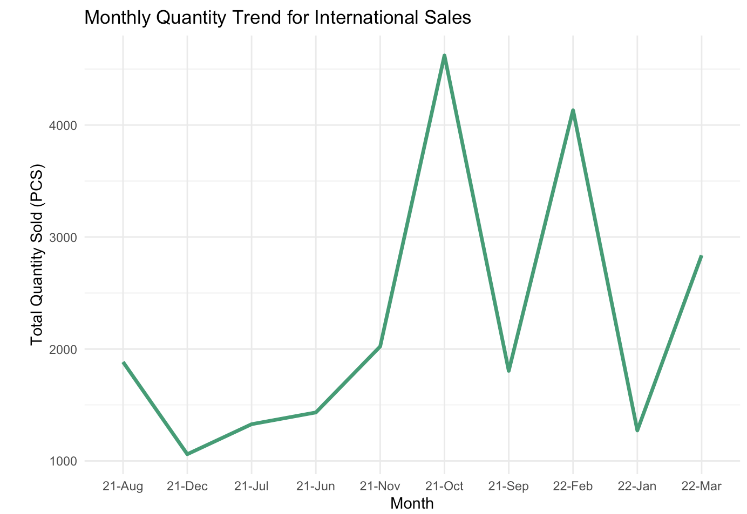
International Sales Show Strong Revenue Peaks but Volatile Demand Patterns
Key Takeaway: International markets contribute meaningfully to revenue,
but growth remains event-driven and inconsistent.
Future strategy should focus on stabilizing global fulfillment and diversifying regional demand cycles.

Slide 14
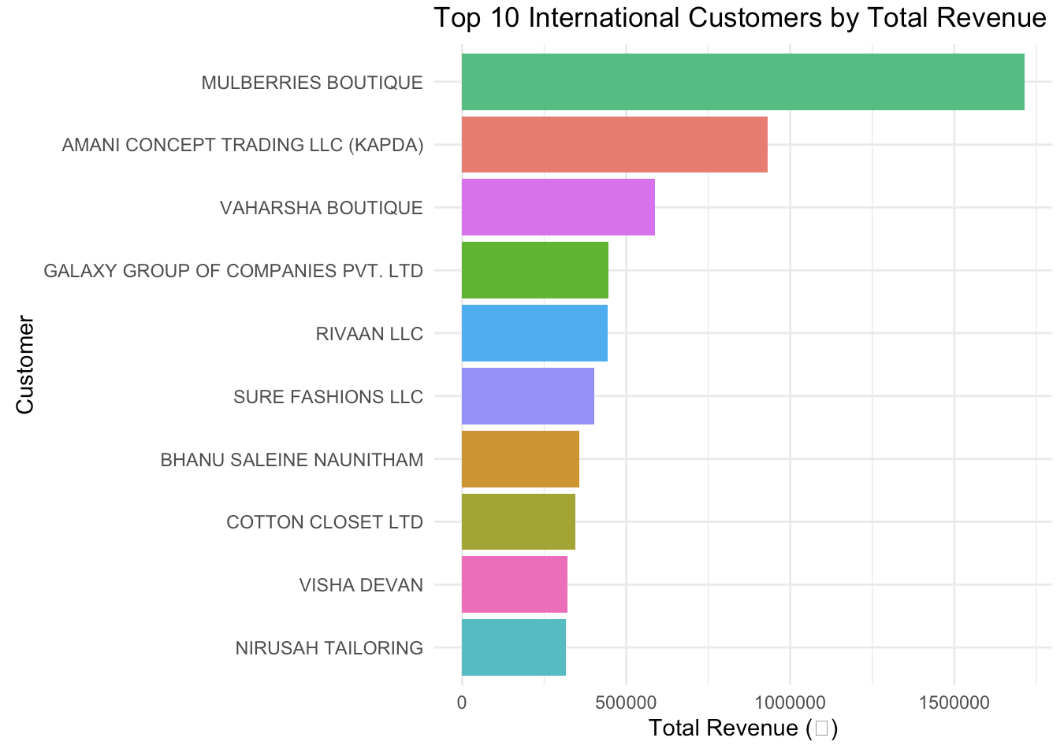
International Revenue Is Concentrated Among a Few Key Buyers
Key Takeaway:
International growth is profitable but fragile—revenue is concentrated in a few large buyers.
Diversifying partners and regions will reduce risk and stabilize sales.

Slide 15
Summary
Domestic strength: Amazon fulfillment dominates volume and reliability.
Profit drivers: Price discipline and catalog structure predict margins better than seasonality.
International growth: High peaks but volatile demand, driven by few large buyers.
Strategic gap: Dependence on limited clients and markets increases revenue risk.
Key Insights: Profitability Is Structural, Growth Is Uneven

Slide 16
Strategic Recommendations
Market Diversification
Expand into underrepresented international regions; onboard new wholesale partners
Impact:
1
Buyers expect an integrated sales experience across in-store and online.
Pricing Optimization
Use model insights (price_ratio thresholds) to adjust margin bands
2
Most customers learn about our products through social media and influencer content.
Operational Focus
Prioritize Amazon-fulfilled logistics for reliability and conversion
3
Our products and services have a stable user base throughout the year.

Slide 17
Dataset Source
https://www.kaggle.com/datasets/thedevastator/unlock-profits-with-e-commerce-sales-data
Kaggle – Unlock Profits with E-Commerce Sales Data
Created by Anil Kumar Anik

